Slide 1
This is the Title slide. Please add the course title in the Dummy Course Title section and duration of the course in the Course Duration section.
Please add the graphic description here.
Container Orchestration -Kubernetes
Notes:
Please add the audio note here.

Slide 2
Container Orchestration
This is one of the Teach slides which can be used for scripting the content pages. The stylization of the slide supports text on top and icons below layout.
The icons given here also indicate which type of icons will go best with the template.
Please add the graphic description here.
Kubernetes Overview
Containers –Docker
Container –Orchestration ?
Demo – Setup
Kubernetes concepts – PODs | ReplicaSets | Deployments | Services
Networking in Kubernetes
Kubernetes management – kubectl
Kubernetes definition file – YAML
Kubernetes in cloud – AWS/GCP
Icon 3
Notes:
Please add the audio note here.

Slide 3
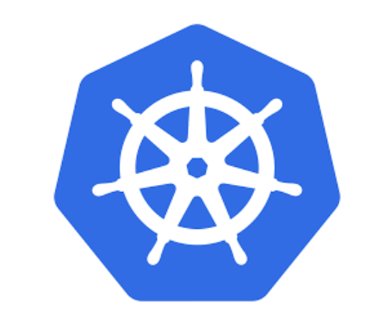
Kubernetes Overview
This is one of the Teach slides which can be used for scripting the content pages. The stylization of the slide supports text on top and icons below layout.
The icons given here also indicate which type of icons will go best with the template.
Please add the graphic description here.
Kubernetes
Kubernetes (K8s) is an open-source system for automating deployment, scaling, and management of containerized applications.
“Kubernetes is a Container Orchestrator, that abstracts
the underlying infrastructure. (Where the containers are run)”.
Icon 1
Icon 2
Icon 3
Notes:
Please add the audio note here.

Slide 4
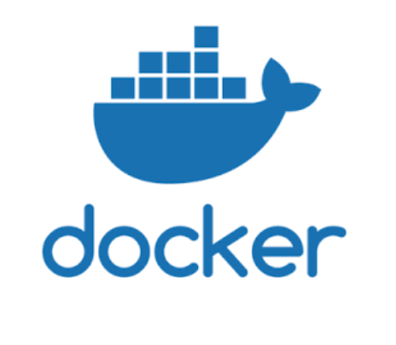
Containers - Docker
This is one of the Teach slides which can be used for scripting the content pages. The stylization of the slide supports text on top and icons below layout.
The icons given here also indicate which type of icons will go best with the template.
Please add the graphic description here.
Kubernetes is a container orchestrator.
Understandably we need containers to be able to orchestrate them. But what are containers? This is best answered from the Documentation at docker.
A container image is a lightweight, stand-alone, executable package of a piece of software that includes everything needed to run it: code, runtime, system tools, system libraries, settings. Available for both Linux and Windows based apps, containerized software will always run the same, regardless of the environment.
It means that containers can run on any computer — even in the production server — with no differences.
Icon 2
Icon 3
Notes:
Please add the audio note here.

Slide 5
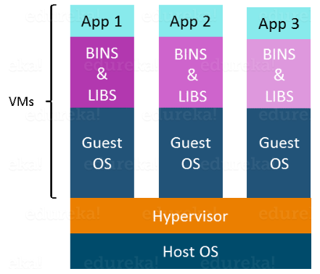
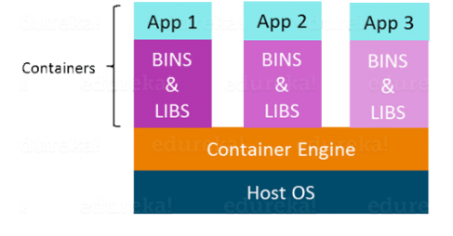
Containers
This is one of the Teach slides which can be used for scripting the content pages. The stylization of the slide supports text on top and icons below layout.
The icons given here also indicate which type of icons will go best with the template.
Please add the graphic description here.
Containers
Icon 1
Icon 2
Icon 3
Notes:
Please add the audio note here.

Slide 6
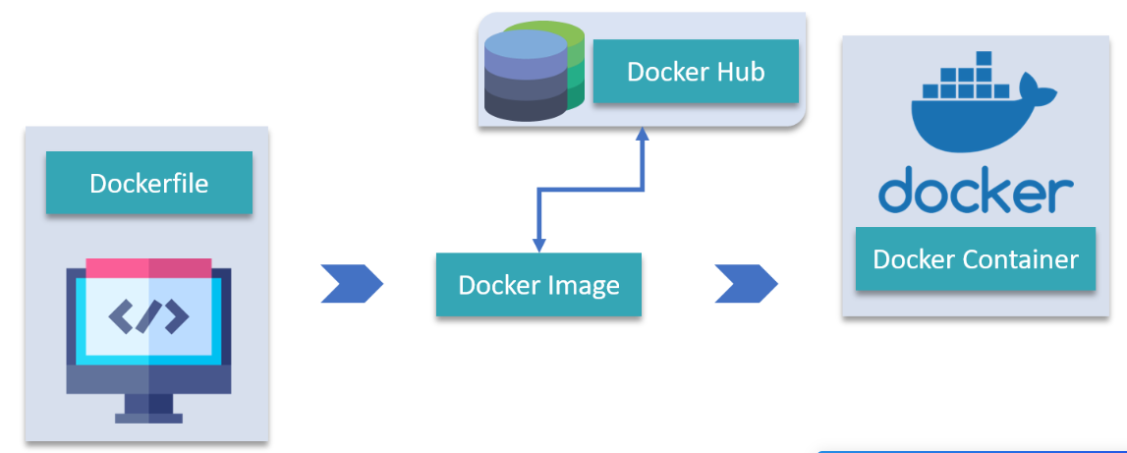
Containers
This is one of the Teach slides which can be used for scripting the content pages. The stylization of the slide supports text on top and icons below layout.
The icons given here also indicate which type of icons will go best with the template.
Please add the graphic description here.
Containers
Icon 1
Icon 2
Icon 3
Notes:
Please add the audio note here.

Slide 7
Demo Time -Docker
DEMO

Slide 8
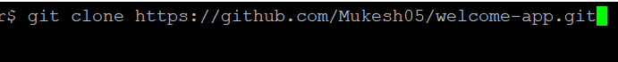
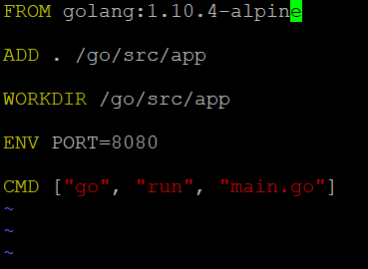
Containers -Docker
This is one of the Teach slides which can be used for scripting the content pages. The stylization of the slide supports text on top and icons below layout.
The icons given here also indicate which type of icons will go best with the template.
Please add the graphic description here.
Clone the below repo :
cd into repo directory and build image from Dockerfile
Create container from the image
Dockerfile3
Icon 2
Notes:
Please add the audio note here.

Slide 9
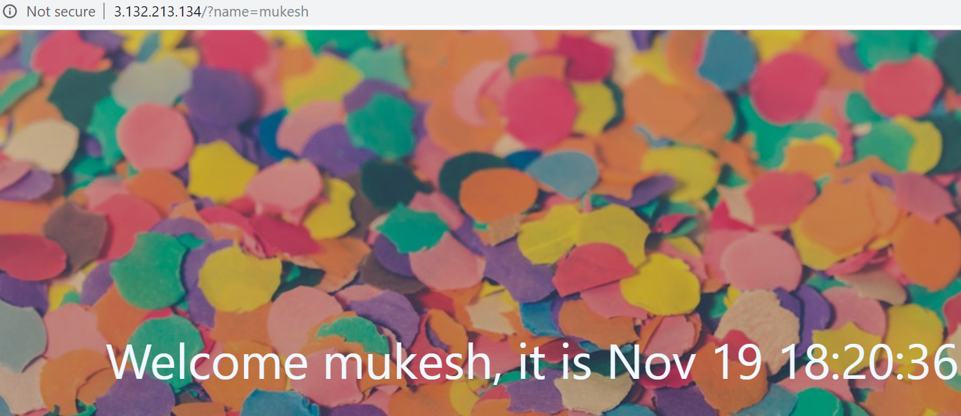
Container - Docker
This is one of the Teach slides which can be used for scripting the content pages. The stylization of the slide supports text on top and icons below layout.
The icons given here also indicate which type of icons will go best with the template.
Please add the graphic description here.
Icon 1
Icon 2
Icon 3
Notes:
Please add the audio note here.

Slide 10
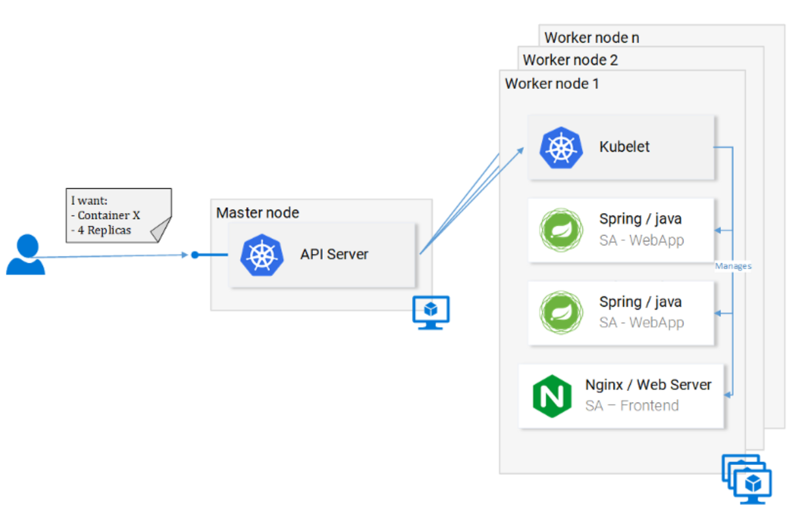
Kubernetes
This is one of the Teach slides which can be used for scripting the content pages. The stylization of the slide supports text on top and icons below layout.
The icons given here also indicate which type of icons will go best with the template.
Please add the graphic description here.
Kubernetes Architecture
Kubernetes abstracts the underlying infrastructure by providing us with a simple API to which we can send requests. Those requests prompt Kubernetes to meet them at its best of capabilities
Icon 1
Icon 2
Icon 3
Notes:
Please add the audio note here.

Slide 11
Kubernetes
This is one of the Teach slides which can be used for scripting the content pages. The stylization of the slide supports text on top and icons below layout.
The icons given here also indicate which type of icons will go best with the template.
Please add the graphic description here.
Kubernetes Architecture
Kubernetes abstracts the underlying infrastructure by providing us with a simple API to which we can send requests. Those requests prompt Kubernetes to meet them at its best of capabilities
Icon 1
Icon 2
Icon 3
Notes:
Please add the audio note here.

Slide 12
Kubernetes
This is one of the Teach slides which can be used for scripting the content pages. The stylization of the slide supports text on top and icons below layout.
The icons given here also indicate which type of icons will go best with the template.
Please add the graphic description here.
Kubernetes Core Components
Control Plane
Worker Node Components
Icon 1
Icon 2
Icon 3
Notes:
Please add the audio note here.

Slide 13
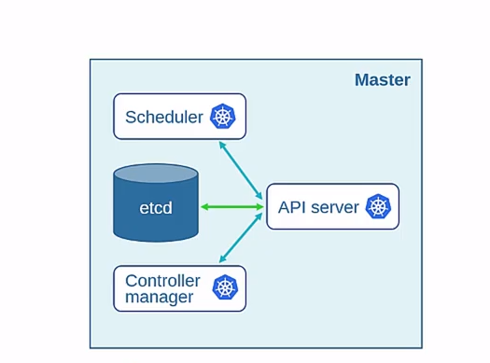
Kubernetes
This is one of the Teach slides which can be used for scripting the content pages. The stylization of the slide supports text on top and icons below layout.
The icons given here also indicate which type of icons will go best with the template.
Please add the graphic description here.
Control Plane
Master node :
etcd : distributed database that stores cluster information in key-value format
Scheduler : identifies the correct node to place a container on
Controller Manager –
Node Controller : ensures addition of a node to a cluster
Replication Controller : makes sure desired number of pods are running
API Server : primary management control system. Exposes kubernetes API which external parties use to communicate with the system
Icon 3
Notes:
Please add the audio note here.

Slide 14
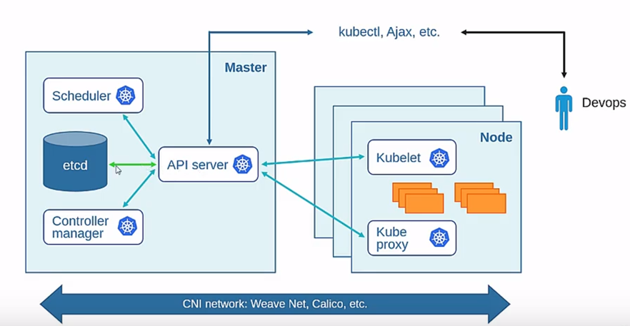
Kubernetes
This is one of the Teach slides which can be used for scripting the content pages. The stylization of the slide supports text on top and icons below layout.
The icons given here also indicate which type of icons will go best with the template.
Please add the graphic description here.
Worker nodes :
Kubelet : primary component on a worker node. Communicates with API server
Kube proxy: enables communication between containers within pods across different nodes
Icon 3
Notes:
Please add the audio note here.

Slide 15
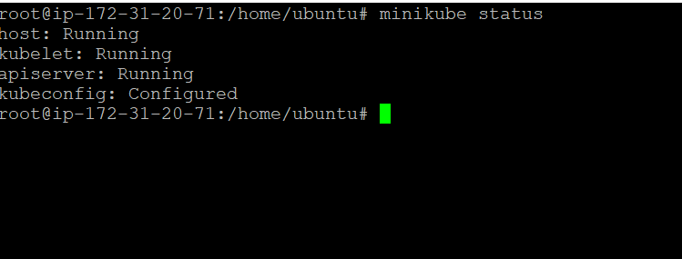
Kubernetes
This is one of the Teach slides which can be used for scripting the content pages. The stylization of the slide supports text on top and icons below layout.
The icons given here also indicate which type of icons will go best with the template.
Please add the graphic description here.
Minikube Install
Minikube creates a local VM and runs a single node cluster.
During Minikube installation, you will also install Kubectl. This is a client to make requests to the Kubernetes API Server.
$ minikube version
$ minikube start –-wait=false
Icon 1
Icon 2
Icon 3
Notes:
Please add the audio note here.

Slide 16
Kubernetes
This is one of the Teach slides which can be used for scripting the content pages. The stylization of the slide supports text on top and icons below layout.
The icons given here also indicate which type of icons will go best with the template.
Please add the graphic description here.
Kubectl
Most widely used CLI in kubernetes.
Kubectl is a command line interface for running commands against Kubernetes clusters.
kubectl [command] [TYPE] [NAME] [flags]
kubectl get service
kubectl apply -f service-sa-logic.yaml
Icon 1
Icon 2
Icon 3
Notes:
Please add the audio note here.

Slide 17
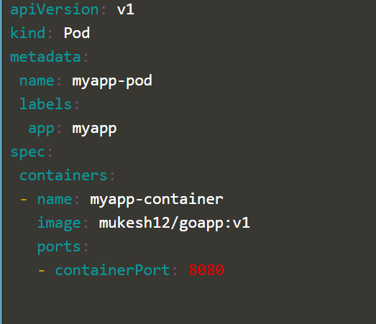
Kubernetes
This is one of the Teach slides which can be used for scripting the content pages. The stylization of the slide supports text on top and icons below layout.
The icons given here also indicate which type of icons will go best with the template.
Please add the graphic description here.
Kubernetes concepts – PODs
smallest deployable compute unit
encapsulates an application’s container, storage resources, a unique network IP, and options that govern how the container(s) should run.
Docker is the most common container runtime used in a Kubernetes Pod, but Pods support other container runtimes as well such as contianerd, rkt
Icon 2
Notes:
Please add the audio note here.

Slide 18
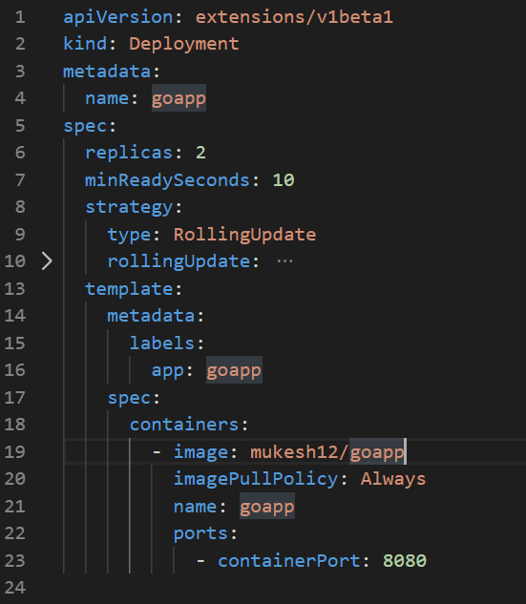
Kubernetes
This is one of the Teach slides which can be used for scripting the content pages. The stylization of the slide supports text on top and icons below layout.
The icons given here also indicate which type of icons will go best with the template.
Please add the graphic description here.
Kubernetes concepts – Deployments
Deployments represent a set of multiple, identical Pods with no unique identities
Runs multiple replicas of the application and automatically replaces any instances that fail or become unresponsive
The Pod template contains the following instructions for Pods created by this Deployment
Each pod is labelled app: goapp
Create one container and name it goapp
Run the mukesh12/goapp:v1 image
Open port 8080 to send and receive traffic
Icon 1
Icon 2
Icon 3
Notes:
Please add the audio note here.

Slide 19
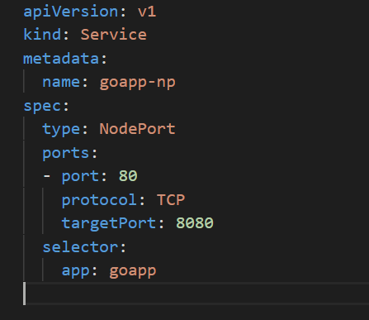
Kubernetes
This is one of the Teach slides which can be used for scripting the content pages. The stylization of the slide supports text on top and icons below layout.
The icons given here also indicate which type of icons will go best with the template.
Please add the graphic description here.
Kubernetes concepts – Services
Enables communication between various component within and outside of the application
Helps in establishing connectivity to external data source
Type of Service :
NodePort
Cluster IP
LoadBalancer
Icon 1
Icon 2
Icon 3
Notes:
Please add the audio note here.

Slide 20
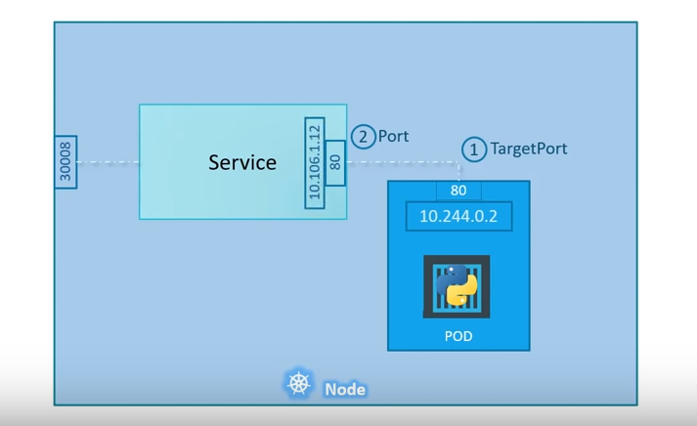
Kubernetes
This is one of the Teach slides which can be used for scripting the content pages. The stylization of the slide supports text on top and icons below layout.
The icons given here also indicate which type of icons will go best with the template.
Please add the graphic description here.
Service – NodePort
TargetPort : port on the container
Port : Service port
NodePort : port on the node hosting the container
These all ports are relative to service object
Icon 1
Icon 2
Icon 3
Notes:
Please add the audio note here.

Slide 21
Kubernetes
This is one of the Teach slides which can be used for scripting the content pages. The stylization of the slide supports text on top and icons below layout.
The icons given here also indicate which type of icons will go best with the template.
Please add the graphic description here.
Networking in Kubernetes
The Container Network Interface (CNI) defines how the different nodes and their workloads should communicate.
Popular ones for CNI enabled Kubernetes cluster :
Weave Net
Calico
Icon 1
Icon 2
Icon 3
Notes:
Please add the audio note here.

Slide 22
Demo Time -Kubernetes
DEMO

Slide 23
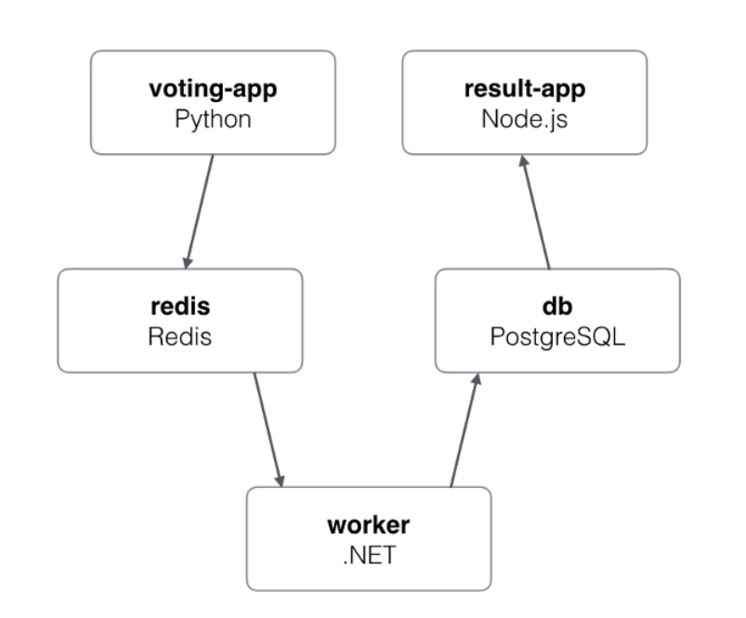
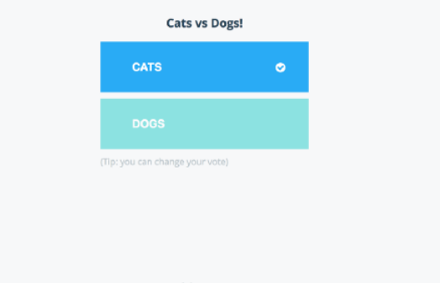
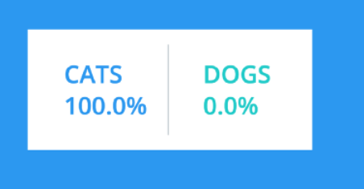
Demo Time -Kubernetes

Slide 24
Kubernetes
This is one of the Teach slides which can be used for scripting the content pages. The stylization of the slide supports text on top and icons below layout.
The icons given here also indicate which type of icons will go best with the template.
Please add the graphic description here.
clone and cd into the
Icon 1
Icon 2
Icon 3
Notes:
Please add the audio note here.

Slide 25
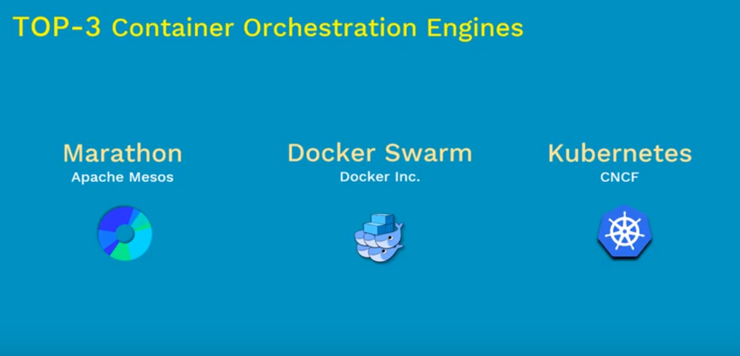
Kubernetes
This is one of the Teach slides which can be used for scripting the content pages. The stylization of the slide supports text on top and icons below layout.
The icons given here also indicate which type of icons will go best with the template.
Please add the graphic description here.
Icon 1
Icon 2
Icon 3
Notes:
Please add the audio note here.

Slide 26
Kubernetes
This is one of the Teach slides which can be used for scripting the content pages. The stylization of the slide supports text on top and icons below layout.
The icons given here also indicate which type of icons will go best with the template.
Please add the graphic description here.
Why Kubernetes is so popular :
Strongest community behind kubernetes than any other container orchestrator platform
Strong patronage from Google.
Builds upon 15 years of experience of running production workloads at Google
Icon 1
Icon 2
Icon 3
Notes:
Please add the audio note here.

Slide 27
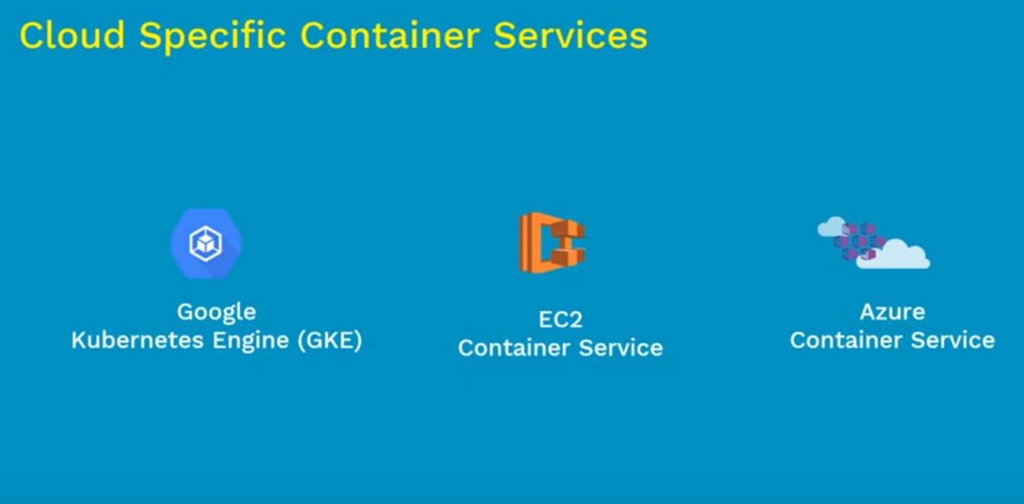
Kubernetes
This is one of the Teach slides which can be used for scripting the content pages. The stylization of the slide supports text on top and icons below layout.
The icons given here also indicate which type of icons will go best with the template.
Please add the graphic description here.
Icon 1
Icon 2
Icon 3
Notes:
Please add the audio note here.

Slide 28
Kubernetes
This is one of the Teach slides which can be used for scripting the content pages. The stylization of the slide supports text on top and icons below layout.
The icons given here also indicate which type of icons will go best with the template.
Please add the graphic description here.
Kubernetes definition file – YAML
Icon 1
Icon 2
Icon 3
Notes:
Please add the audio note here.

Slide 29
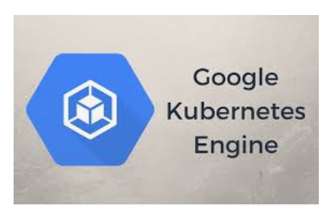
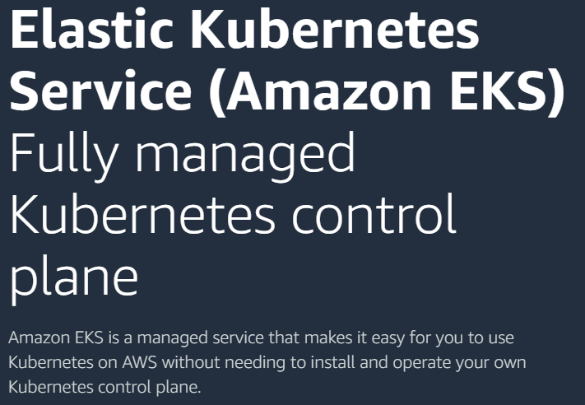
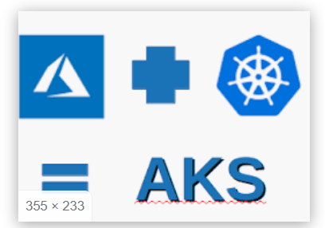
Kubernetes
This is one of the Teach slides which can be used for scripting the content pages. The stylization of the slide supports text on top and icons below layout.
The icons given here also indicate which type of icons will go best with the template.
Please add the graphic description here.
Kubernetes in cloud – AWS/GCP
Icon 1
Icon 2
Notes:
Please add the audio note here.

Slide 30
Kubernetes
This is one of the Teach slides which can be used for scripting the content pages. The stylization of the slide supports text on top and icons below layout.
The icons given here also indicate which type of icons will go best with the template.
Please add the graphic description here.
References :
https://kubernetes.io/docs/concepts
Voting app architecture [https://github.com/docker/example-voting-app]
https://www.freecodecamp.org/news/a-friendly-introduction-to-kubernetes-670c50ce4542/
Icon 1
Icon 2
Icon 3
Notes:
Please add the audio note here.

Slide 31
Kubernetes
This is one of the Teach slides which can be used for scripting the content pages. The stylization of the slide supports text on top and icons below layout.
The icons given here also indicate which type of icons will go best with the template.
Please add the graphic description here.
Kubernetes Service vs Deployment
A deployment is responsible for keeping a set of pods running.
A service is responsible for enabling network access to a set of pods.
We could use a deployment without a service to keep a set of identical pods running in the Kubernetes cluster. The deployment could be scaled up and down and pods could be replicated. Each pod could be accessed individually via direct network requests (rather than abstracting them behind a service), but keeping track of this for a lot of pods is difficult.
We could also use a service without a deployment. We'd need to create each pod individually (rather than "all-at-once" like a deployment). Then our service could route network requests to those pods via selecting them based on their labels.
Services and Deployments are different, but they work together nicely.
Icon 1
Icon 2
Icon 3
Notes:
Please add the audio note here.

